Slide 1
Integrated Sensor Network (for an IIoT service)
Name: Rushi James Macwan
ECEN 5613 – Embedded System Design (Spring-2019)
Final Project Presentation

Slide 2
About the project
This project is focussed on understanding a typical Industrial Internet-of-Things product.
The idea is to provide valuable information to the subscribers of the service through a wireless platform (e.g. e-mail communication).
In this project, an emphasis is laid on understanding how information is collected from sensors.
The complexity of this project lies mostly in understanding the firmware design that can bring up the hardware components together.

Slide 3
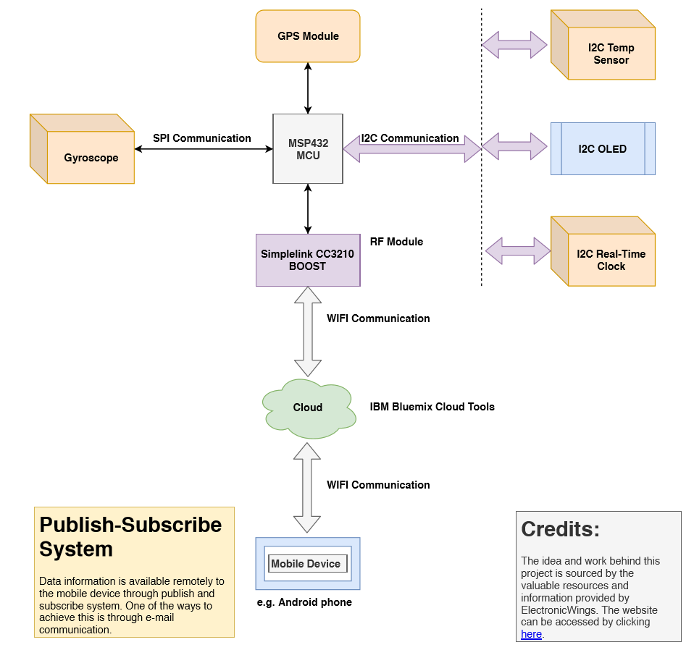
Block Diagram

Slide 4
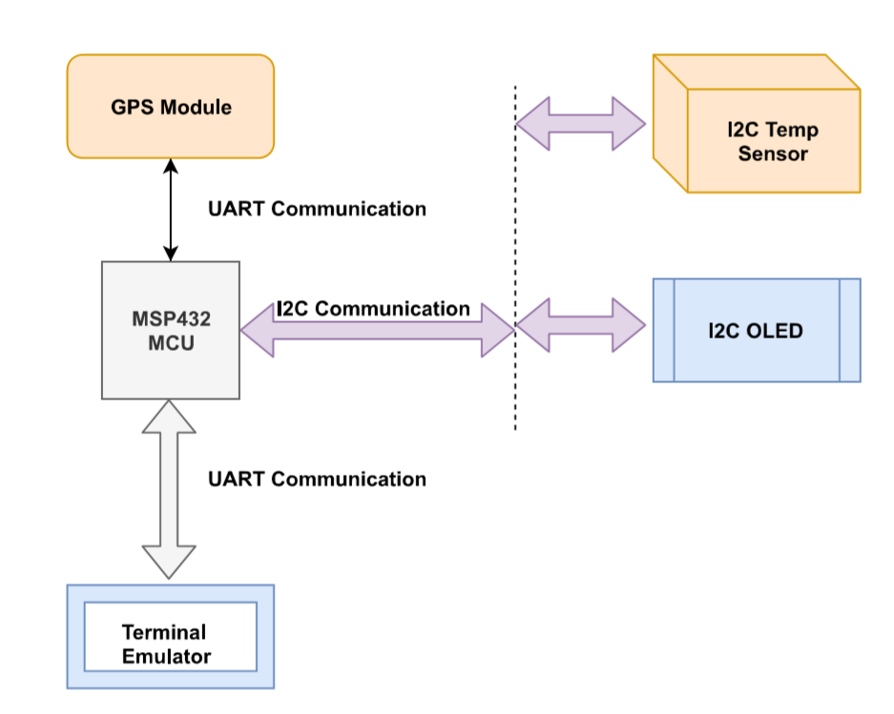
Reduced Block Diagram

Slide 5
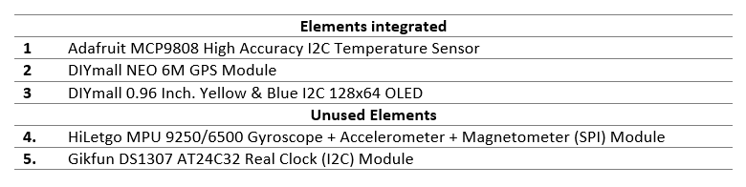
Hardware Elements

Slide 6
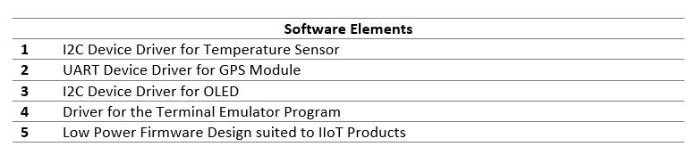
Software Elements

Slide 7
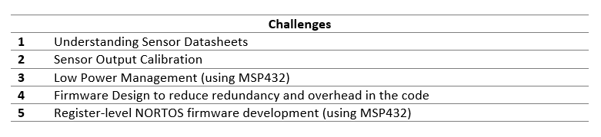
Challenges

